Slide 1

UNI QUICK
Uni-Quick is dedicated to refining the dining experience for FAST University students and faculty. By streamlining the food ordering process and keeping patrons informed about daily offerings, Uni-Quick alleviates the challenges associated with navigating the diverse array of campus eateries.With its user-friendly interface, Uni-Quick offers a seamless solution for placing orders, browsing menus and customizing dining preferences.
Presentation Prepared By: SYED IBAD ASIM

Slide 2
PROBLEM STATEMENT
At FAST University, students and faculty encounter difficulties in navigating
the wide array of meal choices. Identifying appropriate food, reviewing
menus, and placing orders can prove cumbersome and time-consuming.
Moreover, staying informed about daily specials and promotions presents
challenges, resulting in missed chances for savings and an unsatisfactory
dining experience.

Slide 3

FEATURES
Streamlined Ordering Process
Personalized Orders
Real-time Order Tracking
Convenient Payment Integration
Menu Exploration
Advanced Order Placement
Table Reservation System
Incentivized Online Payments
Timely Menu Updates

Slide 4
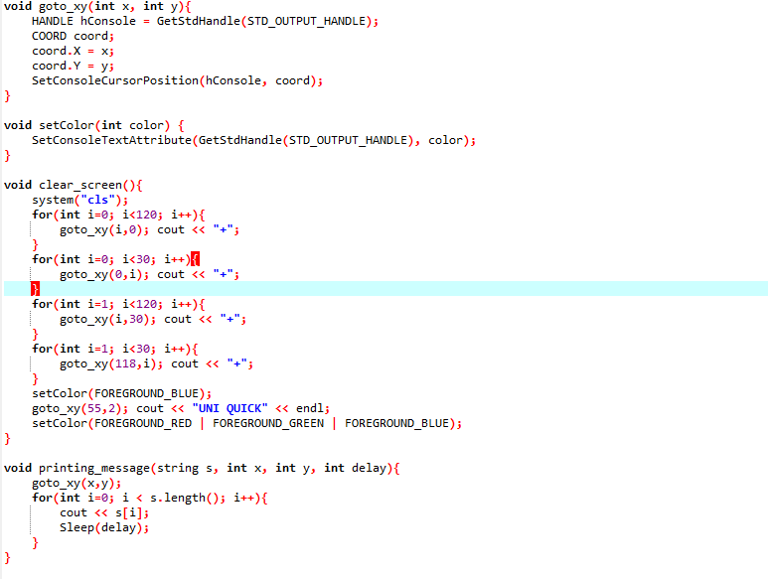
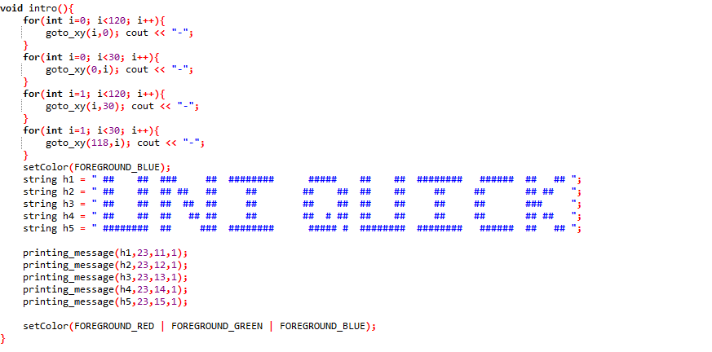
CODE-SOLUTION:
DESIGN AND INTERFACE:

Slide 5
EXPLAINATION
goto_xy(:
Purpose: Moves the console cursor to the specified coordinates (x,y) and is used in every fnction to set the x and y for a better visual look.
Usage: Used for positioning cursor before printing messages or text at specific locations on the console.
setColor(int color):
Purpose: Sets the text color attribute of the console output like the color of uni quick using background and foreground.
Usage: Helps in enhancing visual appeal and readability by changing text colors.
clear_screen():
Purpose: Clears the console screen and sets the text attributes to default.
Usage: Ensures a clean screen before printing new content on the console, enhancing user experience.
printing_message(string s, int x, int y, int delay):
Purpose: Prints a message character by character with a specified delay between each character.
Usage: It creates a typewriter effect for displaying text, enhancing presentation aesthetics.
intro():
Purpose: Displays the program's introduction message with an animated typing effect.
4 Loop Creates Side Borders
Usage: At the beginning of the program execution, sets the stage by presenting the program's title with an engaging animation.

Slide 6
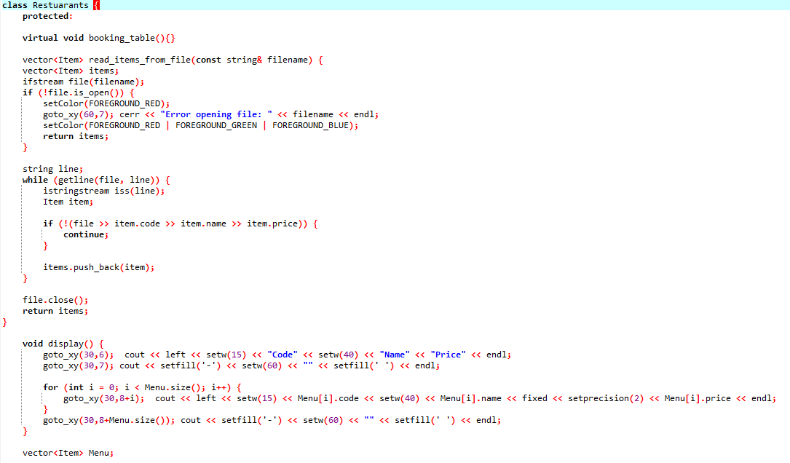
2.Restaurant Class

Slide 7
EXPLAINATION
Struct Item:
Purpose: Represents an item in the restaurant menu.
Members:
code (string): The unique code or identifier for the item.
name (string): The name or description of the item.
price (double): The price of the item.
Usage: Used to store menu items and their corresponding details.
Class Definition: Restaurants
virtual void booking_table():
Purpose: Declares a virtual function for booking tables. It's intended to be overridden by derived classes.
Usage: Allows subclasses to provide their own implementations of table booking.
vector<Item> read_items_from_file:
Purpose: Reads menu items from a file and populates a vector of Item objects.
Parameters:
filename: The name of the file containing menu items.
Returns: A vector of Item objects representing the menu.
Usage: Used internally to load menu items from a file into the Menu vector.
void display():
Purpose: Displays the menu items stored in the Menu vector in a tabular format on the console screen.
Usage: Prints the code, name, and price of each item to provide a clear representation of the menu.
vector<Item> Menu:
Purpose: Stores the menu items of the restaurant.
Usage: Used to maintain the list of available items for ordering.
vector<int> table:
Purpose: Represents the tables in the restaurant. It's intended to store the availability status of each table.
Usage: Provides a data structure for managing table availability.

Slide 8
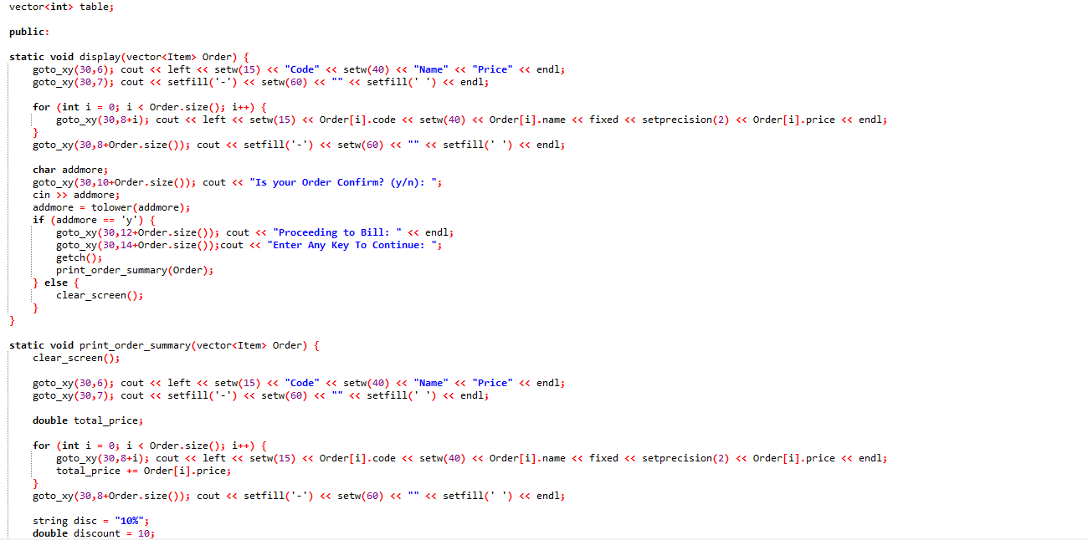

Slide 9
EXPLAINATION
static void display(vector<Item> Order):
Purpose: This static member function displays the order details, including the code, name, and price of each item in the order. It also prompts the user to confirm the order.
Parameters:
Order: A vector of Item objects representing the order.
Implementation:
The function starts by displaying a header with column names for code, name, and price.
It then iterates through each item in the Order vector and displays its details in a tabular format.
After displaying the order details, it prompts the user to confirm the order by entering 'y' for yes or 'n' for no.
If the user confirms the order ('y'), it proceeds to calculate and display the order summary using the print_order_summary function.
If the user does not confirm the order ('n'), it clears the screen.
While iterating, it also calculates the total price of the order.
After displaying the order details, it calculates a discount of 10% on the total price and displays it along with the discounted total price.
Finally, it prints a horizontal line as a separator below the summary.
These static member functions are designed to be called without an instance of the Restaurants class. They provide a convenient way to order details and summaries.
The display function allows users to review their order before confirming, while the print_order_summary function presents a concise summary of the order with pricing information
static void print_order_summary(vector<Item> Order):
Purpose: This static member function prints a summary of the order, including the total price and any applicable discounts.
Parameters:
Order: A vector of Item objects representing the order.
Implementation:
The function starts by clearing the screen to provide a clean interface for displaying the summary.
It then displays a header with column names for code, name, and price using loops.
Price is set to a precision of 2 and setfill for tabular format.
Next, it iterates through each item in the Order vector, displaying its details in a tabular format.

Slide 10
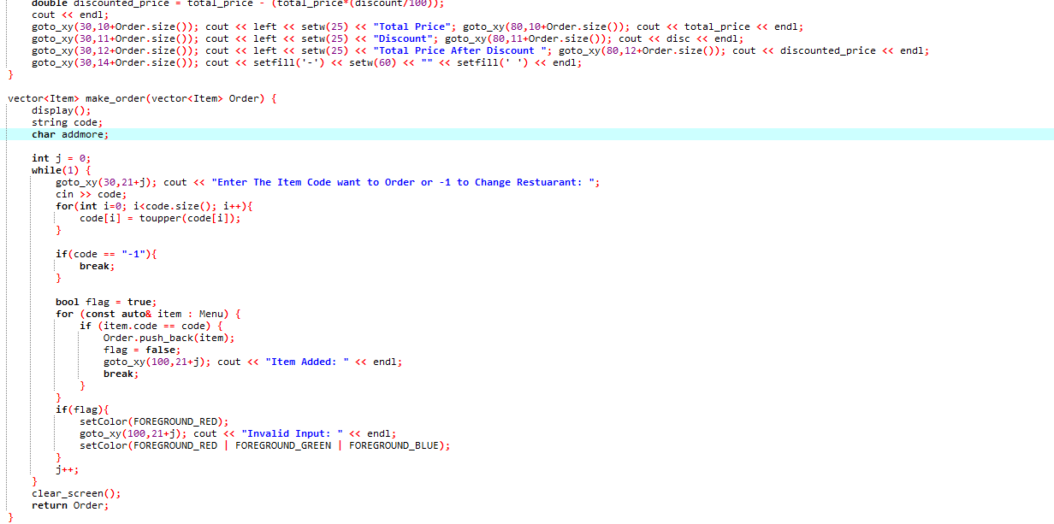

Slide 11
EXPLAINATION
vector<Item> make_order:
Function Definition:
Declares a function make_order that takes a vector of Item objects named Order as a parameter and returns a vector of Item objects.
Display():
Calls the display function to show the menu to the user.
Variable Declarations:
Declares string variable code to store the user's input for the item code.
Declares character variable addmore to store the user's input for adding more items or not.
Initializes integer variable j to 0 to track the position for displaying messages to the user.
User Input Loop:
Initiates an infinite loop to take user input for ordering items.
Displays a prompt for the user to enter the item code they want to order or -1 to change the restaurant.
Reads the user's input for the item code and stores it in the code variable.
Converts the user's input to uppercase to ensure case-insensitive comparison with the item codes.
Checks if the user entered -1 to change the restaurant. If so, breaks out of the loop.
Item Validation and Addition to Order:
Initializes a boolean variable flag to true to track if the user input was valid.
Iterates through the Menu vector, which contains all available items.
Checks if the entered code matches any item in the menu.
If a match is found, adds the corresponding item to the Order vector.
Sets the flag to false to indicate that a valid item was found and added to the order.
Displays a message confirming that the item was successfully added to the order.
If no valid item was found, displays an error message indicating invalid input.
Screen Clearing and Order Return:
Clears the screen after the user has finished making their order.
Returns the updated Order vector containing the items the user has selected.

Slide 12
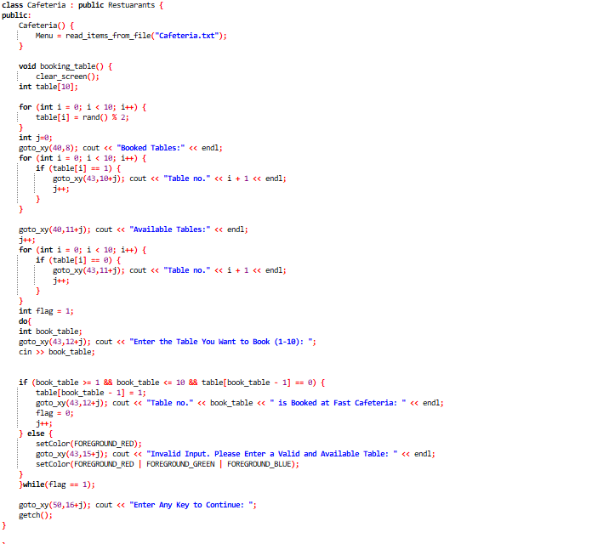
CAFETERIA CLASS:

Slide 13
EXPLAINATION
Constructor Cafeteria:
Inherits from the Restaurants class.
Reads items from a file named "Cafeteria.txt" and assigns them to the Menu vector using the read_items_from_file function inherited from the Restaurants class.
Menu has special code CAF for café, PZ for Pizza Fast and so on.
Function booking_table():
The screen is cleared the screen to provide a clean interface for booking tables.
Declares an array table of size 10 to represent the availability of tables.
Using the loop iterates through each element of the table array and randomly assigns either 0 or 1 to simulate booked or available tables.
Displays the status of booked tables and available tables by iterating through the table array and printing the table numbers accordingly.
Initializes an integer variable flag to 1 to control the loop for booking a table.
Enters a do-while loop to repeatedly prompt the user to enter a table number until a valid and available table is selected.
Reads the user's input for the table number to book.
Validates the input to ensure it is within the range 1-10 and checks if the selected table is available.
If the input is valid and the table is available, marks the selected table as booked in the table array and displays a confirmation message.
If the input is invalid or the table is not available, displays an error message in red color “Invalid Input” and prompts the user to enter a valid table number.
Exits the loop when a valid and available table is booked.
Displays a message to instruct the user to press any key to continue.
Lastly waits for a key press using the getch() function from the <conio.h> library.

Slide 14
SIMILAR CLASSES AND FUNCTIONS: Fast Shawarma, Juice Bar, Dhaba and Pizza Fast have similar functionalities, with same table booking functions available and reading Menu’s from respected places.

Slide 15
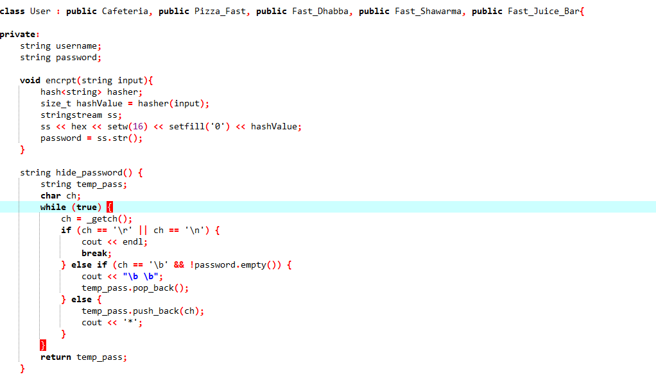
USER CLASS:
Security and Encryption

Slide 16
EXPLAINATION:
encrpt(string input):
This function is responsible for encrypting the user's password.
It takes a string input, which represents the user's password.
Then Utilizes the hash function from the <functional> header to generate a hash value of type size_t for the input password.
After it converts the hash value to a hexadecimal string representation using a stringstream.
Then stores the resulting hexadecimal string in the password member variable.
hide_password():
This function is used to hide the user's input while typing the password.
It does not take any parameters.
Uses _getch() from the <conio.h> header to capture each character input by the user without echoing it to the console.
While the user is entering the password:
If the entered character is a carriage return (\r) or newline (\n), indicating the end of the password input, the function terminates and returns the entered password.
If the entered character is a backspace (\b) and the password is not empty, it erases the last character from the displayed password and removes the last character from the temporary password string.
Otherwise, it appends the entered character to the temporary password string and displays an asterisk (*) on the screen to mask the input.
After the password input is complete, the function returns the entered password.

Slide 17
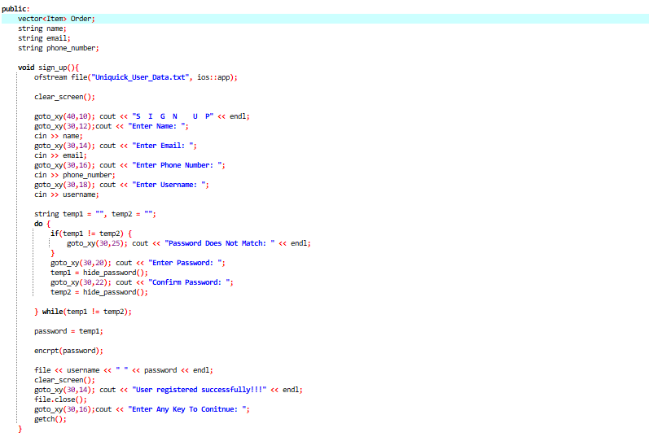
Sign Up Page:

Slide 18
EXPLAINATION:
sign_up():
Opens a file named "Uniquick_User_Data.txt" in append mode, creating it if it doesn't exist.
Clears the console screen.
Displays a "SIGN UP" prompt.
It prompts the user to enter their name, email, phone number, and username, storing each input in the respective member variables.
Prompts the user to enter their password and confirms it by comparing temp1 and temp2 it with the entered password. If the passwords do not match, it displays an error message and repeats the password entry process until they match.
Encrypts the password using the encrpt() function.
Writes the username and encrypted password to the file.
Displays a success message and closes the file.
Prompts the user to press any key to continue.
Gotoxy functions are used for Allignment.

Slide 19
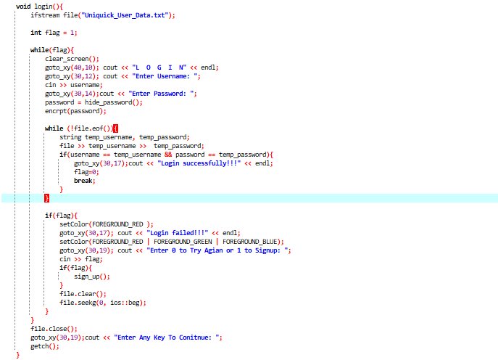
LOGIN PAGE:

Slide 20
EXPLAINATION
login():
Opens the "Uniquick_User_Data.txt" file for reading.
Enters a loop to allow the user to attempt login until successful.
Clears the console screen.
Displays a "LOGIN" prompt.
Prompts the user to enter their username and password.
Encrypts the entered password using the encrpt() function.
Reads each line from the file and compares the entered username and password with those stored in the file.
If a match is found, it displays a success message and exits the loop.
If no match is found, it displays a failure message, allows the user to retry or sign up, and resets the file stream to the beginning.
Once logged in successfully, it closes the file and prompts the user to press any key to continue.

Slide 21
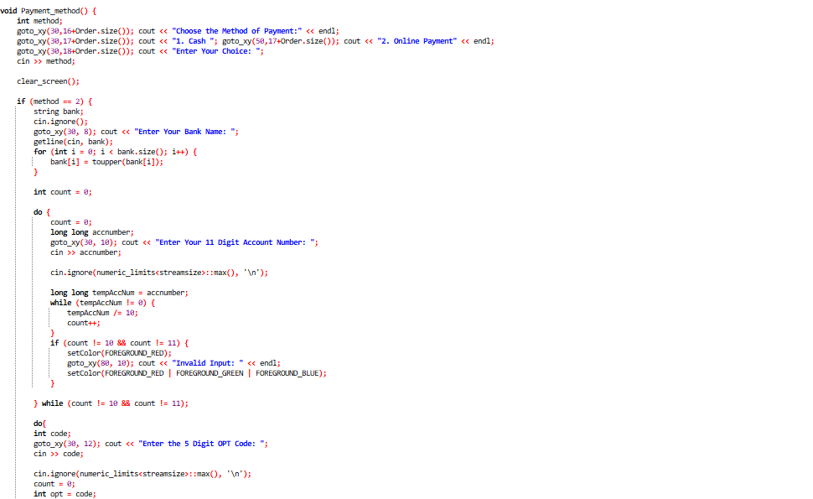
PAYMENT FUNCTION:

Slide 22
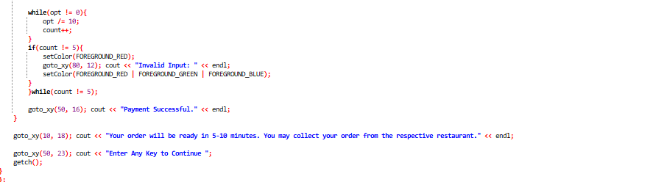
PAYMENT FUNCTION:

Slide 23
EXPLAINATION
Payment_method():
Variable Initialization:
Declares an integer variable method to store the user's choice of payment method. This variable will be used to determine whether the user chooses cash or online payment.
Display Payment Options:
The function presents the user with options to choose the method of payment.
It displays the choices in a clear format.
The prompt guides the user to enter their choice.
Input Handling:
Reads the user's choice of payment method using the cin function.
The input is stored in the method variable for further processing.
4. Online Payment Process:
If the user selects online payment (method == 2):
The function initiates the online payment process.
Prompts the user to enter their bank name using cin.
Converts the bank name to uppercase using a loop to ensure consistency in formatting.
Validates the account number:
The function prompts the user to enter their 11-digit account number using cin.
It then checks the length of the account number using a loop, ensuring it is either 10 or 11 digits long.
If the account number is invalid, the function displays an error message and prompts the user to enter the account number again.
Validates the OTP code:
Prompts the user to enter a 5-digit OTP code for validation.
Validates the OTP code by ensuring it is exactly 5 digits long.
If the OTP code is invalid, the function displays an error message and prompts the user to enter the OTP code again.
Once both the account number and OTP code are validated, the function displays a "Payment Successful" message.
5. Confirmation Message:
Informs the user that their order will be ready in 5-10 minutes and can be collected from the respective restaurant.
This message provides clarity to the user about the next steps after completing the payment process.
Prompts the user to press any key to continue, allowing them to proceed with other actions or exit the program gracefully.

Slide 24
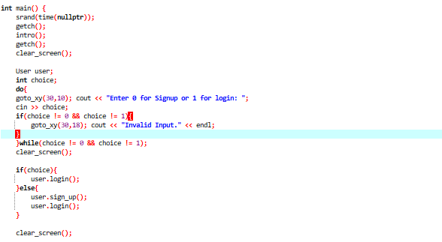
MAIN FUNCTION

Slide 25
EXPLAINATION
Srand(time(nullptr)):
Seeds the random number generator with the current time to ensure different results each time the program runs.
Waits for a key press using getch() to give the user time to prepare before proceeding.
Calls the intro() function to display an introduction to the program.
Waits for another key press to allow the user to view the introduction before clearing the screen.
User Interaction:
Creates an instance of the User class named user.
Declares an integer variable choice to store the user's choice between signup and login.
Enters a do-while loop to ensure the user inputs a valid choice (0 for signup, 1 for login).
Inside the loop, prompts the user to enter their choice and reads it using cin.
If the input is neither 0 nor 1, displays an error message and prompts the user to input again.
The loop continues until the user inputs a valid choice.
Clearing the Screen:
Clears the screen using the clear_screen() function to provide a clean interface for the next steps of the program.
Choose Signup or Login Page:
If the user chooses login (choice == 1):
Calls the login() function of the User class to handle the login process.
If the user chooses signup, if using first time (choice == 0):
Calls the sign_up() of the User class to handle the signup process.
After signup, calls the login() function to ensure the user can log in immediately after signing up.
Clears the screen again to provide a clean interface for any subsequent actions or messages.

Slide 26
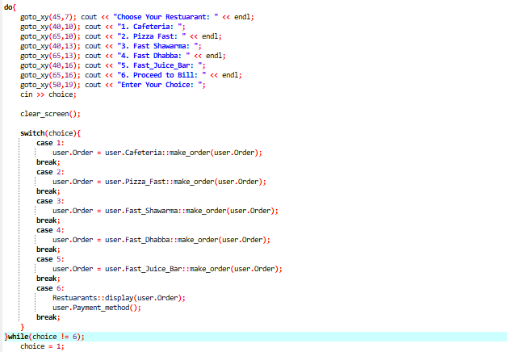
MAIN FUNCTION

Slide 27
EXPLAINATION
do { ... } while (choice != 6):
This is a do-while loop that iterates as long as the user's choice is not equal to 6 (which corresponds to "Proceed to Bill"). This loop structure ensures that the user can keep choosing items from the menu until they are ready to proceed to the bill.
In the loop:
The user is prompted to choose a restaurant from the available options.
After the user selects a restaurant, the corresponding make_order function using scope resolution operator for that restaurant is called, and the user's order is updated accordingly.
If the user chooses option 6, the program displays the order summary using the display function from the Restuarants class, and then proceeds to the payment method by calling the Payment_method function from the User class.
After each iteration of the loop, the user's choice is reset to 1 (to prevent an infinite loop).

Slide 28
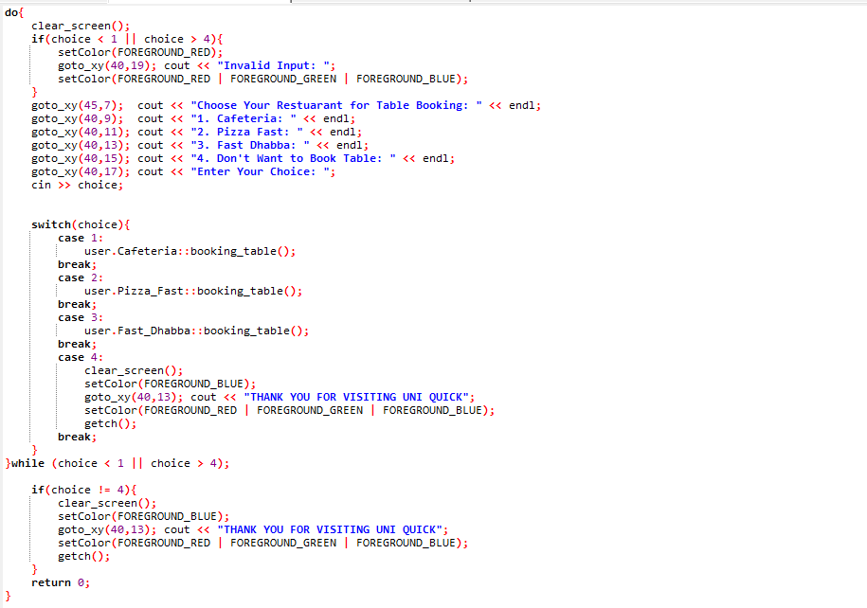
MAIN FUNCTION

Slide 29
EXPLAINATION
do { ... } while (choice < 1 || choice > 4);:
This is a do-while loop that executes until the user chooses an option within the valid range (1 to 4). It ensures that the user can only proceed if they make a valid choice.
Inside the loop:
The screen is cleared to provide a clean interface for the user.
If the user inputs a choice that is less than 1 or greater than 4, an error message is displayed to prompt the user for a valid input.
The user is prompted to choose a restaurant for table booking from the available options.
Based on the user's choice, the corresponding booking_table function of the selected restaurant is invoked.
switch(choice) { ... }:
Depending on the user's choice, a specific restaurant's booking table function is called:
If the user selects option 1, the booking_table function of the Cafeteria class is called.
If the user selects option 2, the booking_table function of the Pizza_Fast class is called.
If the user selects option 3, the booking_table function of the Fast_Dhabba class is called.
If the user selects option 4, the program clears the screen, displays a thank you message, and terminates the loop.
After the loop:
If the user's choice is not 4 (indicating they did not choose to exit), a thank you message is displayed, and the program waits for the user to press any key to continue.
Finally, the program returns 0, and the code is ended successfully.

Slide 30
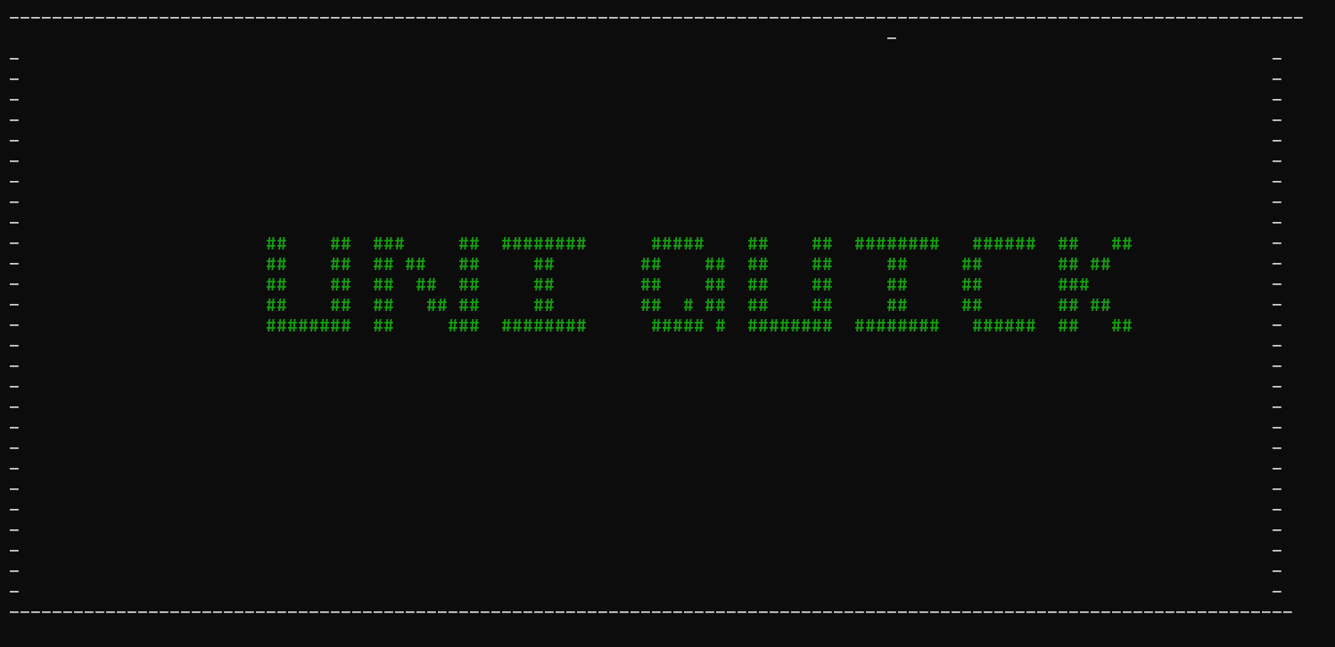
OUTPUT

Slide 31
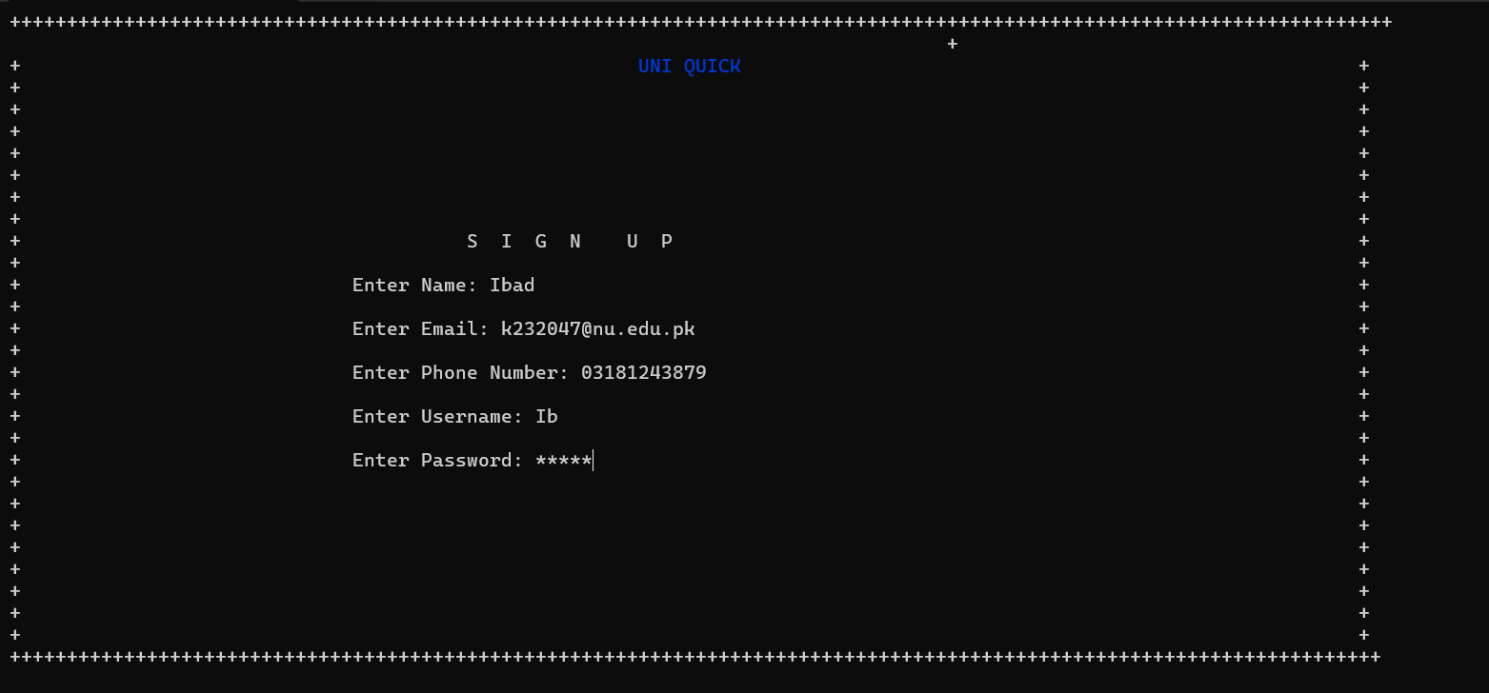

Slide 32
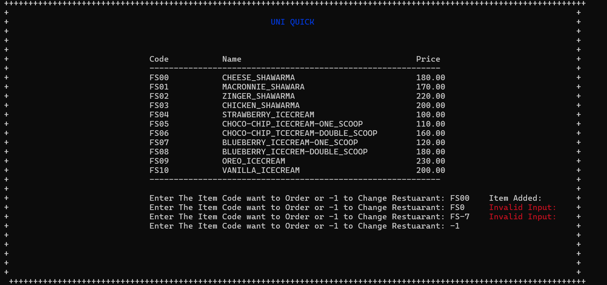
OUTPUT

Slide 33
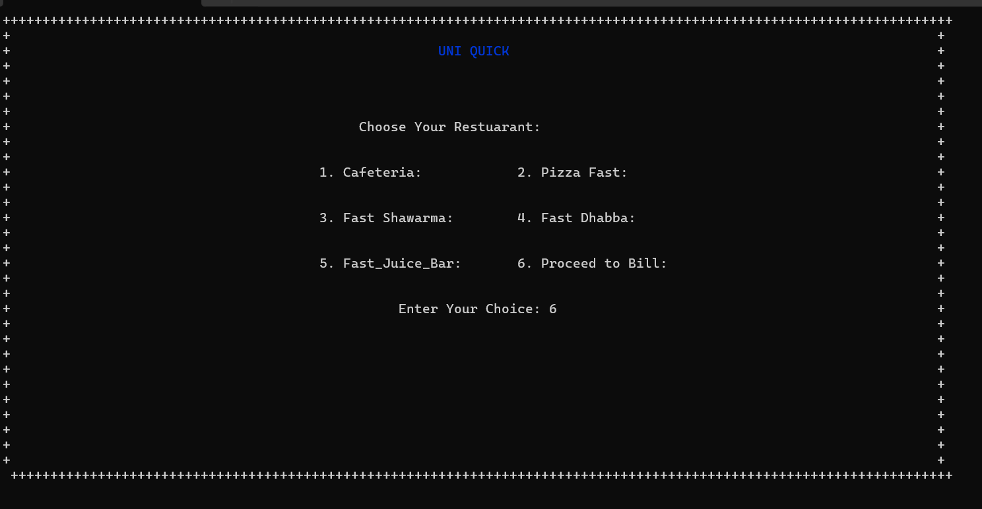


Slide 34
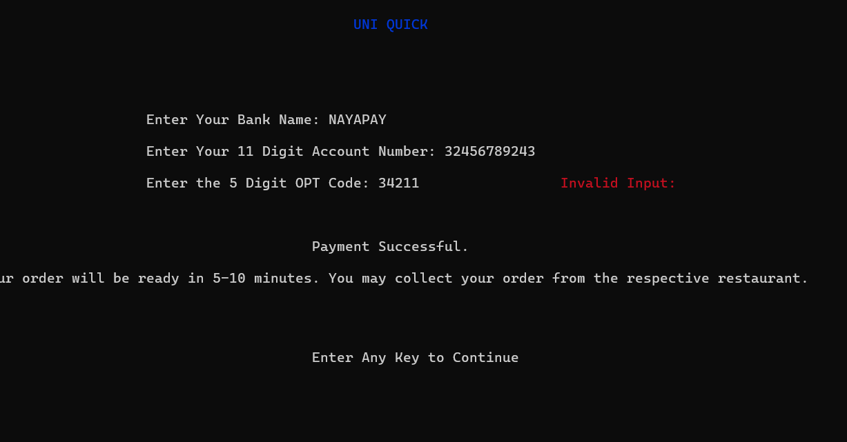

Slide 35
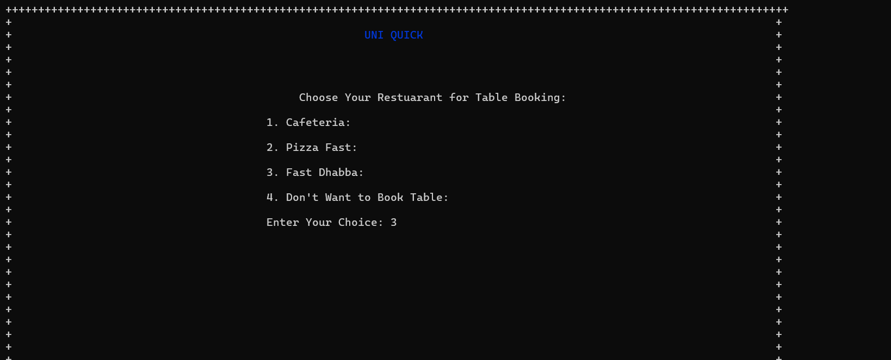
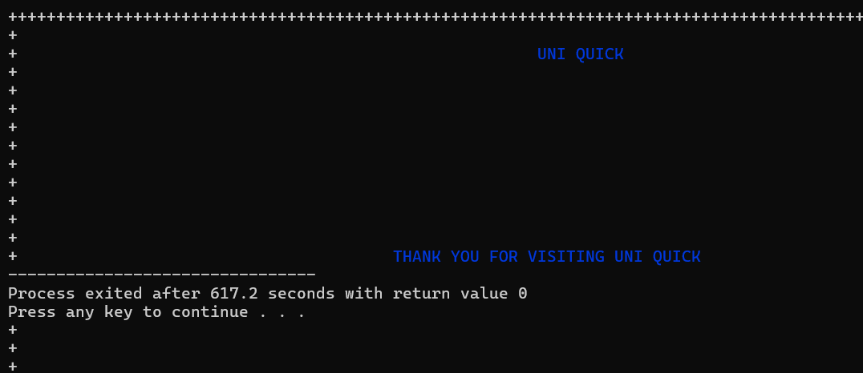

Slide 36
SALIENT FETURES:
Modular Design: The code is structured using classes and functions, promoting modularity and code organization.
User Interaction: The program provides a user-friendly interface with options for sign up, login, restaurant selection, table booking, menu browsing, order placement, and payment.
Encryption: Password is well Encrypted and can be seen on console as well where it is stored.
File Handling: User data is stored and managed using file handling techniques.
Randomization: The use of srand(time(nullptr)) seeds the random number generator, ensuring different results each time the program runs.
Error Handling: Error messages are displayed for invalid inputs or file opening failures, enhancing user experience.
Graphics: The program utilizes ASCII art and console manipulation functions to enhance the visual appeal.
Payment Integration: Supports both cash and online payment methods, ensuring flexibility for users.
Encapsulation: Encapsulation is employed to encapsulate data within classes, enhancing code readability and maintainability.

Slide 37
PROS AND CONS:
Pros:
User-Friendly Interface: The program offers an intuitive interface for users to interact with.
Functionality: It covers various aspects of restaurant management, including user authentication, menu browsing, ordering, and payment.
Scalability: The modular design allows for easy extension and addition of new features or restaurants.
Error Handling: Effective error handling ensures a smooth user experience and prevents program crashes.
Cons:
Limited Error Checking: While error messages are displayed for some cases, more comprehensive error checking could be implemented to handle a wider range of potential issues.
Console Dependency: The program is dependent on console manipulation functions, limiting its portability to other platforms.
Security: The encryption of passwords could be enhanced using stronger encryption algorithms and security practices to protect user data more effectively.

Slide 38
SALIENT FETURES:
Modular Design: The code is structured using classes and functions, promoting modularity and code organization.
User Interaction: The program provides a user-friendly interface with options for sign up, login, restaurant selection, table booking, menu browsing, order placement, and payment.
Encryption: Password is well Encrypted and can be seen on console as well where it is stored.
File Handling: User data is stored and managed using file handling techniques.
Randomization: The use of srand(time(nullptr)) seeds the random number generator, ensuring different results each time the program runs.
Error Handling: Error messages are displayed for invalid inputs or file opening failures, enhancing user experience.
Graphics: The program utilizes ASCII art and console manipulation functions to enhance the visual appeal.
Payment Integration: Supports both cash and online payment methods, ensuring flexibility for users.
Encapsulation: Encapsulation is employed to encapsulate data within classes, enhancing code readability and maintainability.

Slide 39
FUTURE WORK
Enhanced Security: Implement stronger encryption algorithms and security measures to protect user data.
GUI Implementation: Develop a graphical user interface (GUI) to provide a more visually appealing and intuitive user experience.
Database Integration: Transition from file-based storage to database management systems for better data management and scalability.
Internationalization: Support for multiple languages to cater to a broader user base.
Feedback Mechanism: Incorporate a feedback mechanism for users to provide suggestions and comments, improving overall user satisfaction.
PRESENTATTION PREPARED BY: SYED IBAD ASIM

